Slide 1

JavaScript Programming
Information Technology
loops

Slide 2
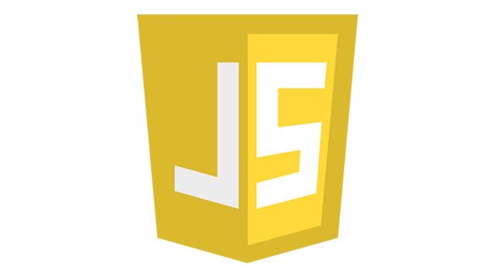
Loops

Slide 3
Loops – Iteration Structures
Used for repeating an operation until a condition is met
Within the loop structure, a question is asked (boolean expression). If the answer is yes (true) then some action is executed
This question is asked repeatedly and action taken until the answer to this question is no
Each time the question is asked is called an iteration

Slide 4
Loops – Loop Types
There are three loop types
for loop
A loop that runs a preset number of times.
while loop
A loop that runs repeatedly until an expression is true.
The expression is evaluated first before any iteration is executed.
Code within this loop type might never execute.
do loop
A loop that runs repeatedly until an expression is true.
The expression is evaluated at the end of each iteration execution.
Code within this loop type is executed at least one time.

Slide 5
For Loop
The syntax of the for loop
for (initializationExpression; booleanExpression; incrementExpression) {
statements
} A for loop that stores the numbers 0 through 19 in a string let numbers = "";
for (let i = 0; i < 20; i++) {
numbers += i + " ";
} The console after the string is printed to it 0 1 2 3 4 5 6 7 8 9 10 11 12 13 14 15 16 17 18 19
Open curly bracket on the same line as the for statement

Slide 6
While Loop
The syntax of the while loop
while(booleanExpression) {
statements
}
A while loop that calculates a future value let i = 1;
let months = 36;
let futureValue = 0.0;
let monthlyInvestment = 100.0;
let monthlyInterestRate = 0.02;
while (i <= months) {
futureValue = (futureValue + monthlyInvestment) * (1 + monthlyInterestRate);
i++
} Be aware of infinite loops while(true){ //Do stuff but do not do anything to break out will last forevvvvvverrrrrrr
}
Open curly bracket on the same line as boolean expression

Slide 7
Do-while Loop
The syntax of the do-while loop
do {
statements
} while(booleanExpression)
A do-while loop that calculates a future value let i = 1;
let months = 36;
let futureValue = 0.0;
let monthlyInvestment = 100.0;
let monthlyInterestRate = 0.02;
do {
futureValue = (futureValue + monthlyInvestment) * (1 + monthlyInterestRate);
i++; } while (i <= months); Be aware of infinite loops do { //Do stuff but do not do anything to break out will last forevvvvvverrrrrrr
} while(true);
Open curly bracket on the same line as the do statement
Closing curly bracket on the same line as the while expression

Slide 8
Exercise
Create Repo JavaScriptProgrammingEx5
Add instructor as collaborator
Clone to you computer
Open the cloned directory in VS Code
Code along

